Slide 1

Enterprise Collaboration Framework
April 17, 2006
Proposal – V6.1

Slide 2

Current Pain Points with Collaboration
Secure Meeting and Met Meeting products turned off 12/05.
Total Conferencing costs average $75K/month exceeding budget by $30K/mo with Live Meeting Costs of $20,000 per month.
Manufacturing needs (and bought) more eRooms licenses for their latest project.
The Dominican Republic plant has requested a replacement for Sametime (Instant Messaging) to assist in plant IT audits.
Competing Collaboration Tool options (SAP, Live Meeting, SharePoint, Interwise).

Slide 3
Business Issues
Immediate need to simplify collaboration between an increasingly distributed workforce.
We need to reduce the costs associated with communications and reduce the need for intra & extra campus travel to better leverage time (our most precious commodity) for our resources (our most valuable assets).
We need the ability to easily capture, find and retrieve knowledge (information, documents and data) across the enterprise.

Slide 4
Business Drivers
COSTS: Immediate need to focus on productivity and cost-saving issues
COMPETITION: Collaboration is a competitive weapon
  Business today is very knowledge based
  The currency of business today is decision making
  The faster and more effective ways we make decisions, the more competitive we are, the more often we will beat our competitors
URGENCY: Companies of all sizes today are starting to realize they must invest in a set of collaboration tools in order to drive business forward
ENTREPRENEURIAL SPIRIT: This has become necessary infrastructure. It is cost justifiable. It adds to our competitive advantage will be gained from investing in it

Slide 5
Business Challenges & Opportunities
Rapid transformation (systems, process, people)
Growing and diversifying business
Consolidating operations
Migrating Legacy Systems and data into an emerging architecture
Training for SAP (required new processes)
Managing Change!
Notes:
Work smarter not just harder,
Collaborate & cooperate on all levels
Leverage investments in IT

Slide 6



Present & Future Scope of Collaboration
Collaboration is most useful in the context of other work
  Who knows the answer?
  Where can I find more information about this?
  What do I do next?
  Does everyone agree?
So, collaboration is shifting from “silos of tools”
… to an enterprise “framework of services”
… creating a seamless integration between resources (employees, partners, customers, suppliers & systems)
  Enterprise Portal (single point of entry)
  Extended ERP (extending SAP)
  Service Architecture
  Knowledge Management (Data, Docs, and Content)
Meetings
Email
Conferencing
Applications
Document Mgmt
Conferencing
Instant Messaging
SAP
Email
Security
Mgmt
Legacy Apps
Meetings
Notes:
Collaboration is most useful in the context of other work
Who knows the answer?
Where can I find more information about this?
What do I do next?
Does everyone agree?
So, collaboration is shifting from “silos of tools”
Email
Conferencing
Applications
Workflow…
… to an enterprise “framework of services”
Email
Conferencing
Applications
Workflow…
… increasingly, embedded in business applications and scenarios – “in context”
Portals
Office Productivity
ERP…

Slide 7
Strategic View of Collaboration
Connect People with People
  Instant Messaging & Live Meeting
Connect People with Information
  Service Architecture & Single Portal
Connect People with Process
  Service Architecture & Workflow
Notes:
Connect People with People
Increase employee productivity by streamlining team communication and collaboration
Increase employee productivity by making better use of existing Intellectual Property (IP)
Reduce operational costs by streamlining processes
Connect People with Information
Increase productivity by empowering employees to quickly discover, access, analyze, and share contextually relevant unstructured and line-of-business information that resides within the organization
Increase partner relations by providing access to product, services and account information that is easy-to-find, accurate, timely, and personalized based on their context
Make better business decisions by analyzing employee, customer and partner traffic and activity in the solution
Reduce operational costs by streamlining processes
Connect People with Process
Increase employee productivity by connecting employees with internal SAP and line-of-business processes through easy-to-use self-service applications
Improve partner relations by providing them with easy-to-use self-service applications over the Web
Reduce operational costs through more efficient and streamlined processes

Slide 8
Tactical View of Collaboration
Routine Uses (Distributed Control)
  Document Presentation and Application Sharing
  Document or Spreadsheet Collaboration
  Workflow coordination
  Instant Messaging for immediate answers
Future Quality Enhancements (Centralized Control)
  Version control
  Central repository
  Public Web access for Read Only
  Third party partners access control

Slide 9
Proposed Solution – A Phased Approach
First – Demonstrate a Proof of Concept, Obtain better data then purchase and implement “Plug-in” standard presentation and collaboration tools
Second – Prototype the Enterprise Portal, Service Architecture, and Meta and Data Architectures
Third – Centralize Change Management and Extend the Framework to include Core Systems (SAP, Sharepoint, Documentum
Fourth – Centralize Configuration Management, Extend the Service Architecture and Implement a Workflow Tool
Fifth – Create communities of interest to solve issues and provide solution to business requirements

Slide 10
Solution: Phase 1
Create POC for Collaboration Framework (see Exhibit D)
Obtain Better Usage Data
Recommend & Purchase a Meeting Facilitation Solution
Recommend & Purchase an Instant Messaging Solution
Recommend an Enterprise Portal Solution
Collaboration Framework:
  Meeting Facilitation Services
  Instant Messaging Services

Slide 11
Benefits
Reduce total operating costs
Ability to easily find and share information
Seamless integration & interoperability
  Across systems, platforms, and geographies
Adaptable to ongoing business change
Reduced need for local and long-distance travel
Ability to engage an increasingly distributed workforce. Work smarter not just harder
  Cooperate and info sharing on all levels
  New ways to leverage IT investments

Slide 12
Benefits
Over time, the ECF will be extended to address the need for:
  Increase our level of responsiveness and integration with business partners
  Mobilize our workforce by provide “immediate” connectivity to key applications regardless of proximity.
  Virtualize our support to provide a sense of on-premise support (anytime, anywhere, we are there…)
  Improved Security and Compliance
  Create communities of interest to spur innovation, foster collaboration amongst employees, suppliers, customers and partners
Notes:
Some additional thoughts to clarify. Our solution will….
Deliver a system of software and services that empowers Hospira’s information workers to drive organization-wide performance
Maximizing employee impact
Reducing information risk
Enabling efficient decision making
Connecting with customers and partners
Key points:
focus is on solutions for information workers (this separates us from Manufacturing and deeply embedded PLM processes)
capabilities are targeted at automating business processes, enabling them to change and simplify how IWs do work
from individual productivity to organizational productivity

Slide 13
Appendix – Proposed Next Steps
FUTURE SOLUTION PHASES
ADJUST BASED UPON
  Results of Phase One
  Emergence of a complete and integrated Enterprise Architecture
  New Data obtained
  Current Business Climate

Slide 14
Solution: Phase 2
Build the Collaboration Framework
  Build the initial presentation layer (*)
  Build the initial set of Services
  Build the initial set of Meta Data
  Build a working pilot in Hospira’s environment
Pilot the Meeting Facilitation Solution
  Includes integration with E-Room
Recommend an Enterprise Search Engine
Implement an Enterprise Portal Solution
(*) We can leverage the Oracle J2EE Portal in the short term
Collaboration Framework:
  ECF Framework
  Meeting Facilitation Services
  Instant Messaging Services

Slide 15
Solution: Phase 3
Implement an Enterprise Search Engine
Recommend an Enterprise Workflow Solution
Extend Collaboration Framework
  Continue extending the Service Architecture, Meta Data
  Begin including the domain components for collaboration (see exhibit B)
  Expand integration to include the core systems (SAP, Sharepoint, E-Room, Documentum)
  Enable centralized tracking for Change Management (see Exhibit C)
Rollout the Meeting Facilitation Solution to all Hospira
Collaboration Framework:
  ECF Framework
  Meeting Facilitation Services
  Instant Messaging Services
  Enterprise Search Services
  Document Mgmt Services
  Workflow Services
  Change Tracking Services

Slide 16
Solution: Phase 4
Implement an Enterprise Workflow solution
Extend Collaboration Framework
  Continue extending the Service Architecture, Meta Data
  Incorporate the domain services for collaboration into the presentation layer (see Exhibit A)
  Continue integrating the domain components for collaboration as services (see exhibit B)
Recommend a solution for facilitating:
  Blogs
  Discussion Threads
  Communities of Interest
Collaboration Framework:
  ECF Framework
  Meeting Facilitation Services
  Instant Messaging Services
  Enterprise Search Services
  Document Mgmt Services
  Workflow Services
  Change Tracking Services
  Enterprise Workflow Services

Slide 17
Solution: Phase 5
Implement a solution for facilitating:
  Blogs
  Discussion Threads
  Communities of Interest
Enable e-learning thru push technologies
Enable distributed mentoring programs
Extend Collaboration Framework
  Continue extending the Service Architecture, Meta Data
  Continue incorporating services from existing legacy systems
Collaboration Framework:
  ECF Framework
  Meeting Facilitation Services
  Instant Messaging Services
  Enterprise Search Services
  Document Mgmt Services
  Workflow Services
  Change Tracking Services
  Enterprise Workflow Services
  Blog Services
  Discussion Thread Services
  Communities of Interest Services
  E-Learning Services
  Distributed Mentoring Services
  Legacy System Services via Portal

Slide 18
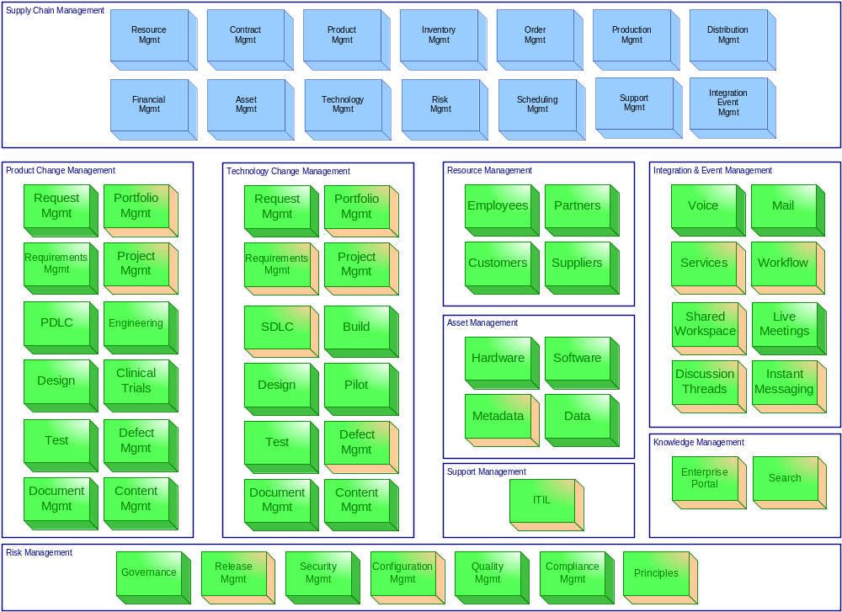
Exhibit A: Domain Analysis for Collaboration

Slide 19
Exhibit B: Architecture Components that Provide Collaboration Services
Opportunity | Status
Project Mgmt | Initiative underway to implement an enterprise PM tool
Portfolio Mgmt | Initiative underway to implement an enterprise PM tool
Requirements Mgmt | TBD
Defect Mgmt | Need a single tool for managing defects associated with the development of software and products across the enterprise. Recommend we avoid point solutions.
Metadata | Need a single logical data store for centrally managing these core assets. This requires a separate more detailed discussion to educate everyone on the need.
Support Mgmt (ITIL) | Initiative underway to pilot process maps aligned with ITIL for Infrastructure. Scope & timelines TBD.
Services | Initial conversations underway with vendors on SOA tools, methodologies and knowledge transfer.

Slide 20
Exhibit B: Architecture Components that Provide Collaboration Services
Opportunity | Status
Workflow | TBD
Shared Workspaces | Held initial discussions with Microsoft partner on their tools. Documented a roadmap to implement.
Discussion Threads | Available through Sharepoint though not implemented. Documented a roadmap to implement.
Document Mgmt | No consistent repository for managing non-validated documents.
Instant Messaging | Held initial discussions with Microsoft partner on their tools. Documented a roadmap to implement.
Enterprise Search | Need a single tool that will provide a consistent, reliable capability to find information, data, and artifacts.
Enterprise Portal | We need to simplify our infrastructure to enable our staff to access tools and information from any point while reducing the complexity and increasing functionality.

Slide 21
Exhibit B: Architecture Components that Provide Collaboration Services
Opportunity | Status
Release Mgmt | TBD. Note: This is critical for managing software, products, content, documents, virtually any artifact that requires versioning and is tied to a project/product.
Principles | An initiative is underway to establish standards for governing change across Technology, Processes and People.
Configuration Mgmt | This is the last and possibly most important opportunity since it is central to how we manage & track change across the enterprise. Currently, we rely on separate systems to manage & track versioning and changes to artifacts. None of these systems tie together, which makes it difficult to plan and manage all of the ongoing changes (let alone assess root cause when one or more artifacts are changing at the same time). [See next slide for an illustration of how we can address this opportunity. ]

Slide 22
Exhibit C: Importance of a Centralized CCMDB
Request
Mgmt
Support
Mgmt
Proposal
Mgmt
Configuration
Mgmt
Portfolio
Mgmt
Change/Config
Mgmt DB
(Tracking)
Source Code
Mgmt
Project
Mgmt
Document
Mgmt
PDLC
-or-
SDLC

Slide 23
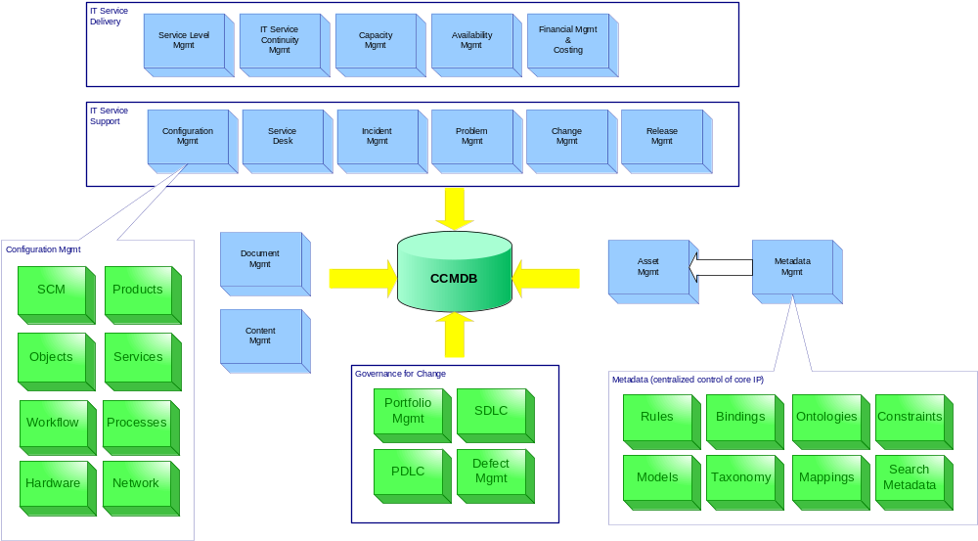
Exhibit C: Domain for Change / Config. Mgmt

Slide 24
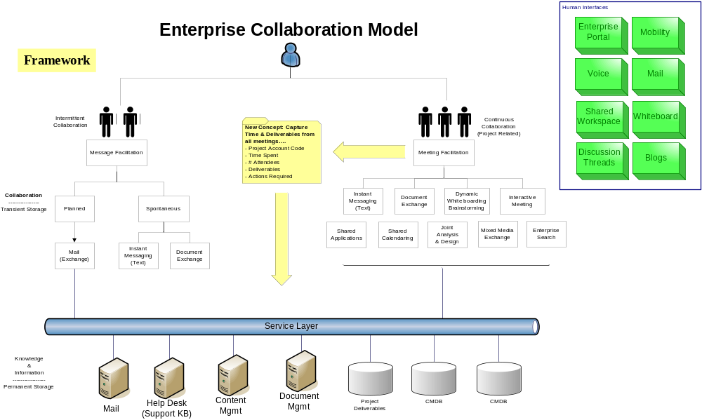
Exhibit D: Conceptual Model for POC
Notes:
Here is an idea…This Exibit should be a “High Level design of Meeting Facilitation” which is a product that will leverage our Enterprise Collaboration Framework…thoughts?

Slide 25
Key Pain Points:
Documentius Electronica
  Everything lives in email and in spreadsheets
Quid-quem exactimus
  All you need to know are two things:
    (a) Exactly what you’re looking for and
    (b) Exactly whom to ask
Ambidextrius Dementia
  Left hand doesn’t know what the right hand is doing Disjointed activities.
Notes:
All of this change is being managed in a distributed manner in a global organization, which makes coordination and collaboration very difficult.

Slide 26
EFC Options
Do Nothing
Dot Net, Sharepoint,
SAP
Collaboration Tolls (Live Meeting or Interwise)
Open Source Tolls

Slide 27
Strategic View of Collaboration – An Investment Opportunity OVERVIEW or Hypotsis
Premise: People are Hospira’s most valuable asset
Opportunity: Hospira can optimize for success by empowering their people with tools that allow them to quickly solve problems and seize business opportunities.
Solution: “Enterprise Collaboration”
  This is all about how we leverage our most valuable resources to coordinate, communicate, and manage change across the entire value chain.”

